Slide 1

Customer churn Analysis
  Faithelizabeth Mburuga
  Collins Kemboi
  Emmaculate Akoth
  Derrick Kuria

Slide 2
Contents
Give the main observations in the churn dataset.
Provide insights obtained about Customer churn in MegaTelco.
1. Objectives
2. Data exploration
3.Model
4.insights
5.Recommendations
Lay the intent and target of the churn project.
The model chosen, its accuracy and the reason.
Suggest recommendations to deploy.

Slide 3
Objectives
What is the problem?
Customer Churn –This is an instance where customers switch from MegaTelco and subscribe to other telecommunication service providers.
How to solve this problem?
Build a model/ models that predicts whether a customer stays or cancels the subscription with our business entity MegaTelco.

Slide 4
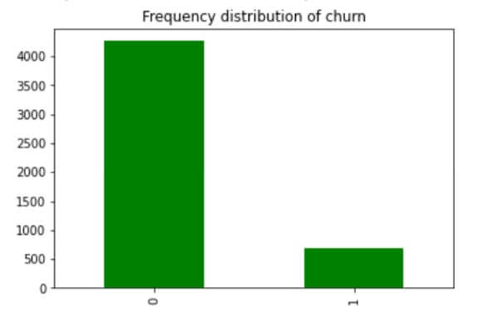
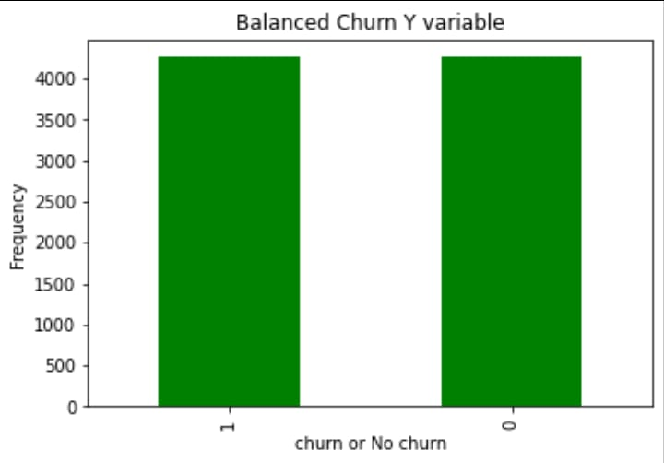
Data Exploration
This is a representation of Customers who had churned and those who had not churned.
Customers who had not churned is 4261.
The number of those who had churned is 691
From this the data is imbalanced.
This is a representation of our balanced Megatelco dataset.
Now the number of Churned and not churned customers is at 4261.
Now the dataset is balanced.

Slide 5
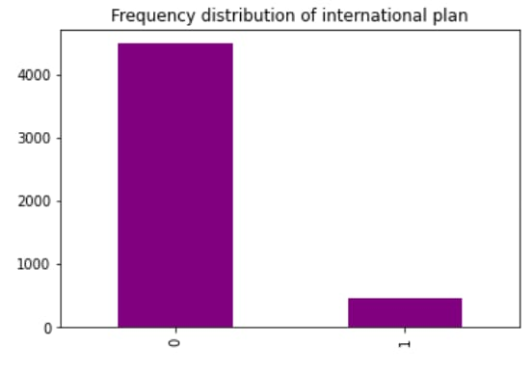
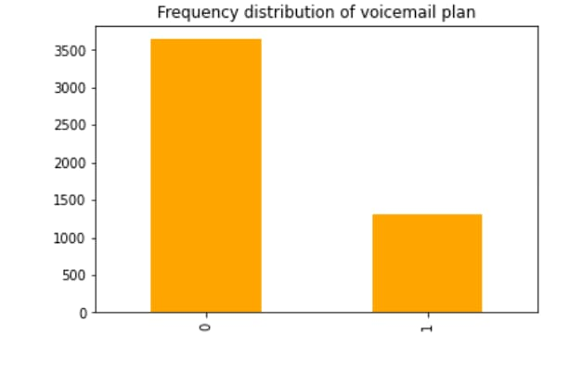
Data Exploration(CONT’d)
An estimate of about 25% of MegaTelco customers did not have a voicemail plan.
Most MegaTelco customers did not have an international plan.

Slide 6
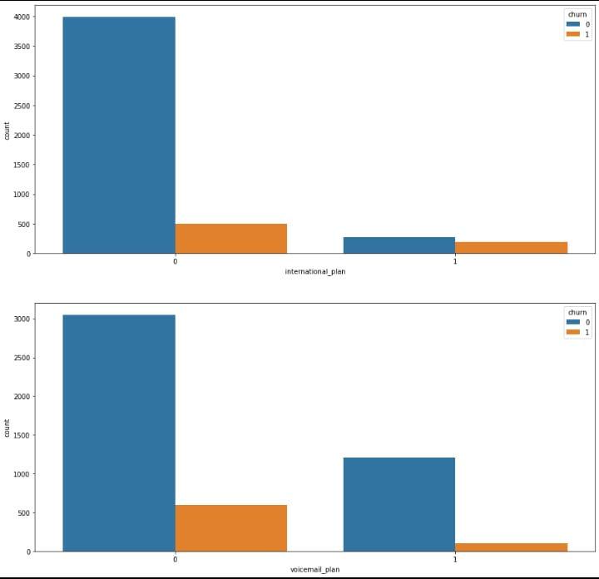
Data Exploration(CONT’D)
Those without an international Plan were more likely to churn from MegaTelco than those with an international plan
Customers without a voicemail plan were more likely to churn from MegaTelco than those with a voicemail plan

Slide 7
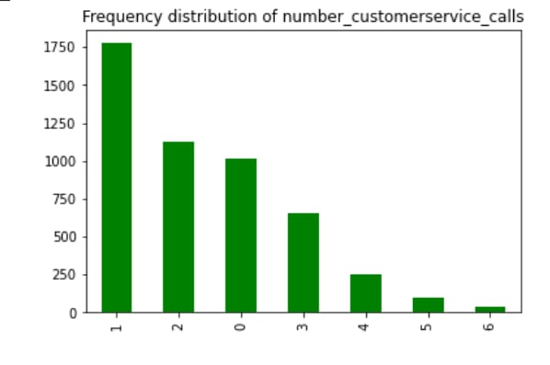
Data Exploration(CONT’D)
Most MegaTelco Customers had 1 or 2 Customer Service calls

Slide 8
Model
We did 5 models to get the best accuracy level .
Two models had a 99% accuracy but we did not choose those to avoid over fitting.
We chose , a KNN model which had a 96% accuracy level.

Slide 9
INSIGHTS
From a business perspective, there are three ways to ensure your business is scaling for profits, productivity and growth.
1. Upselling to existing customers.(persuade customers to buy additional products)
2. Acquiring new customers.
3. Increasing customer retention.(customer churn reduction)

Slide 10

INSIGHTS
What are the reasons that would cause a customer to churn from MegaTelco.
Pricing promotions by competitors are likely to entice customers to churn from a business entity like MegaTelco.
Lack of connection capabilities would make a customer shift allegiance to a network service provider with a wider network coverage.
Slow and poor customer services would be a stumbling block to customer retention.
New competitors are more likely to have better streamlined services and cause customer churn to the service providers who have been existing
1.Competitors Price
2. Service Quality
3.Poor Customer service
4. New competitors

Slide 11
Insights
Customers who had made Customer care calls were likely to churn from MegaTelco.
Most customers had made one or two Customer care calls.
Customers without subscribed plans were more likely to churn.

Slide 12
Recommendations
Ask for feedback
Listen to the customers
Stay competitive
To avoid customer churn, loyal customers are always anticipating changes, new advertisements , better rates and good performance compared to competitors. Hence, staying competitive shows continued vigorous activity and focus towards the end product to the customer
A loyal customer is always willing to give feedback on how to make the product better. .Ask for feedback using surveys and calls. For all answers surveys, giving an incentive would be a good act of appreciation to the customer. This increases loyalty to the product.
This Is not only taking grievances by customers but by also ensuring that the customer care department is up and running. Also the customer care agents should be receptive and accommodating to the different characters of customers

Slide 13
Recommendations
Compare rates with rivals
Offer product and service incentives
Introduce new plans
Some rates may be exaggerated and be way too high compared to competitors. It is in order to have international and domestic rates almost the same as the competitors so as to reduce churn due to prices.
Customers in every business entities yearn and expect incentives from the companies. MegaTelco could offer incentives like free Night calls , subsidized prices for subscription plans and reduced rates for international calls. This incentives are sometimes way cheaper than losing a customer
Since customers with plans are less likely to churn, MegaTelco should increase plans. New plans could include Free weekend Nights, subsidized prices on frequent calls and subsidies on long stayed customers.

Slide 14
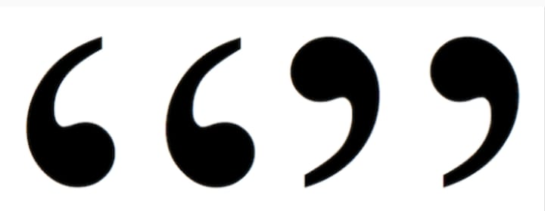
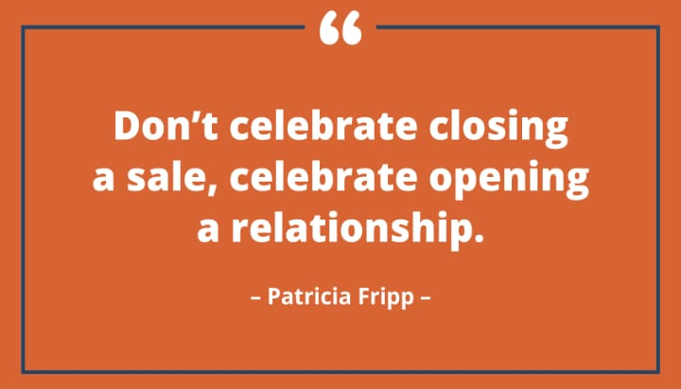
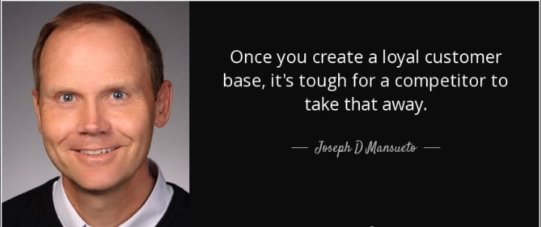
Customer retention Quotes
Your best customer is your existing customer.
anonymous

Slide 15


